Slide 1

Team - H2O_U3108 Team Leader - Trusha Talati
Team Member - Akshat Bhat
(H2O Wave App Link Demo Video attached in zip file submission)

Slide 2

Overview of Approach
Below is the screenshot of our H2O Wave App’s home page which provides an overview of our approach. The AQI forecasting methodology is explained in the following slides.

Slide 3
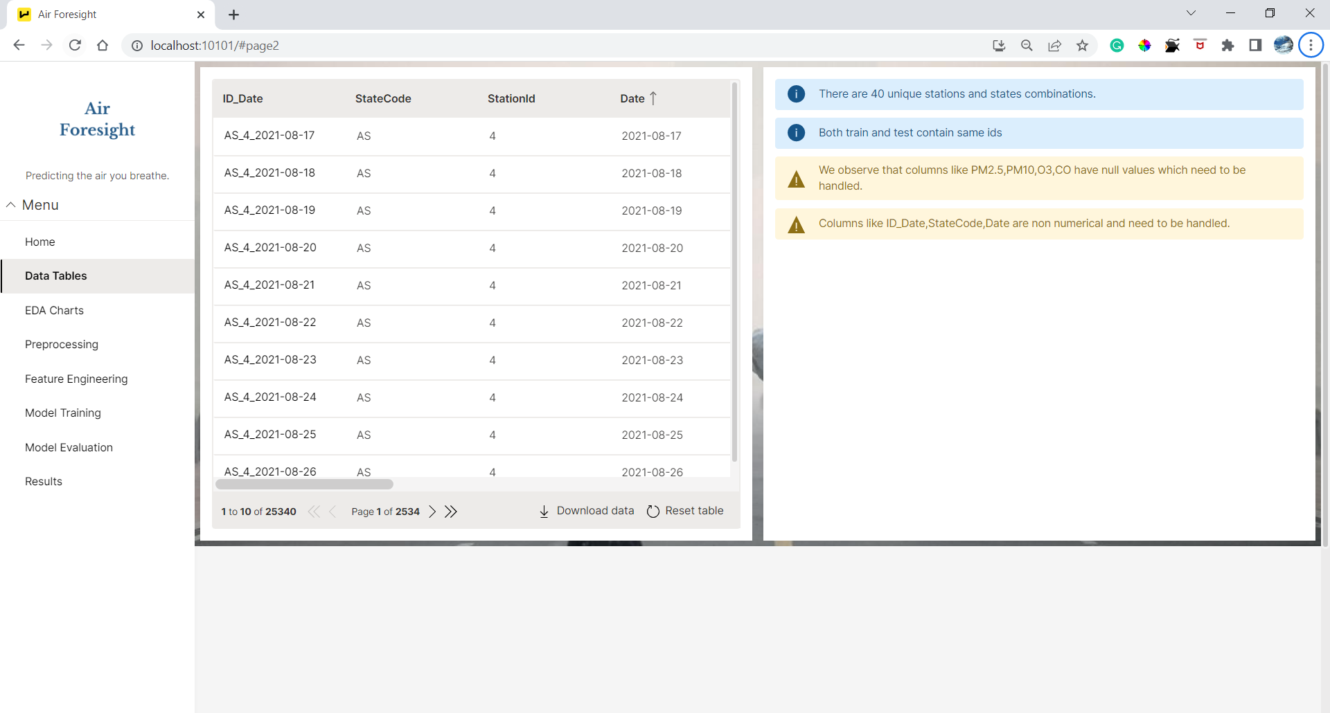
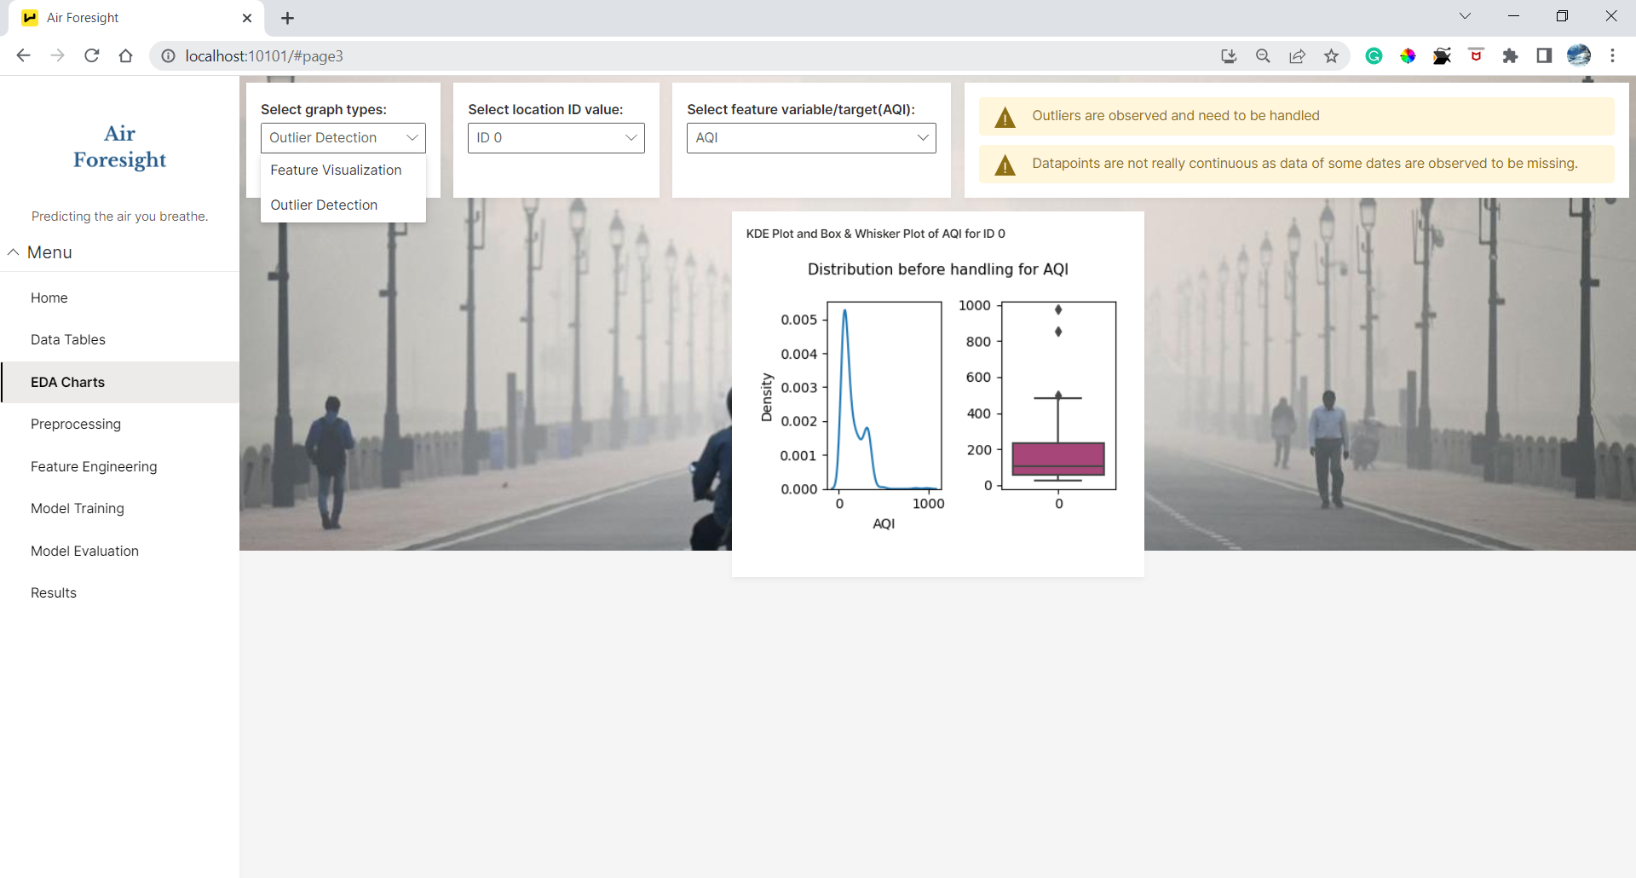
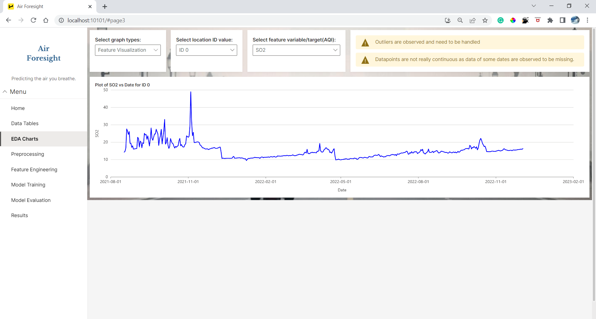
AQI Forecasting Methodology
Upon EDA , we conducted following preprocessing steps which helped improve MMAE:
Constructing ‘ID’ column (0 to 39 i.e. 40 locations) by concatenating StateCode and StationId
Missing values handling by imputation and spline interpolation of pollutants
Handling missing dates data, which increased the data provided from 25340 to 25823 data points
Outlier Handling using IQR for skewed data
Feature Extraction from ‘Date’ column
Scaling and Standardization of feature variables
Predicting future exogenous variables using Auto-ARIMA
,

Slide 4
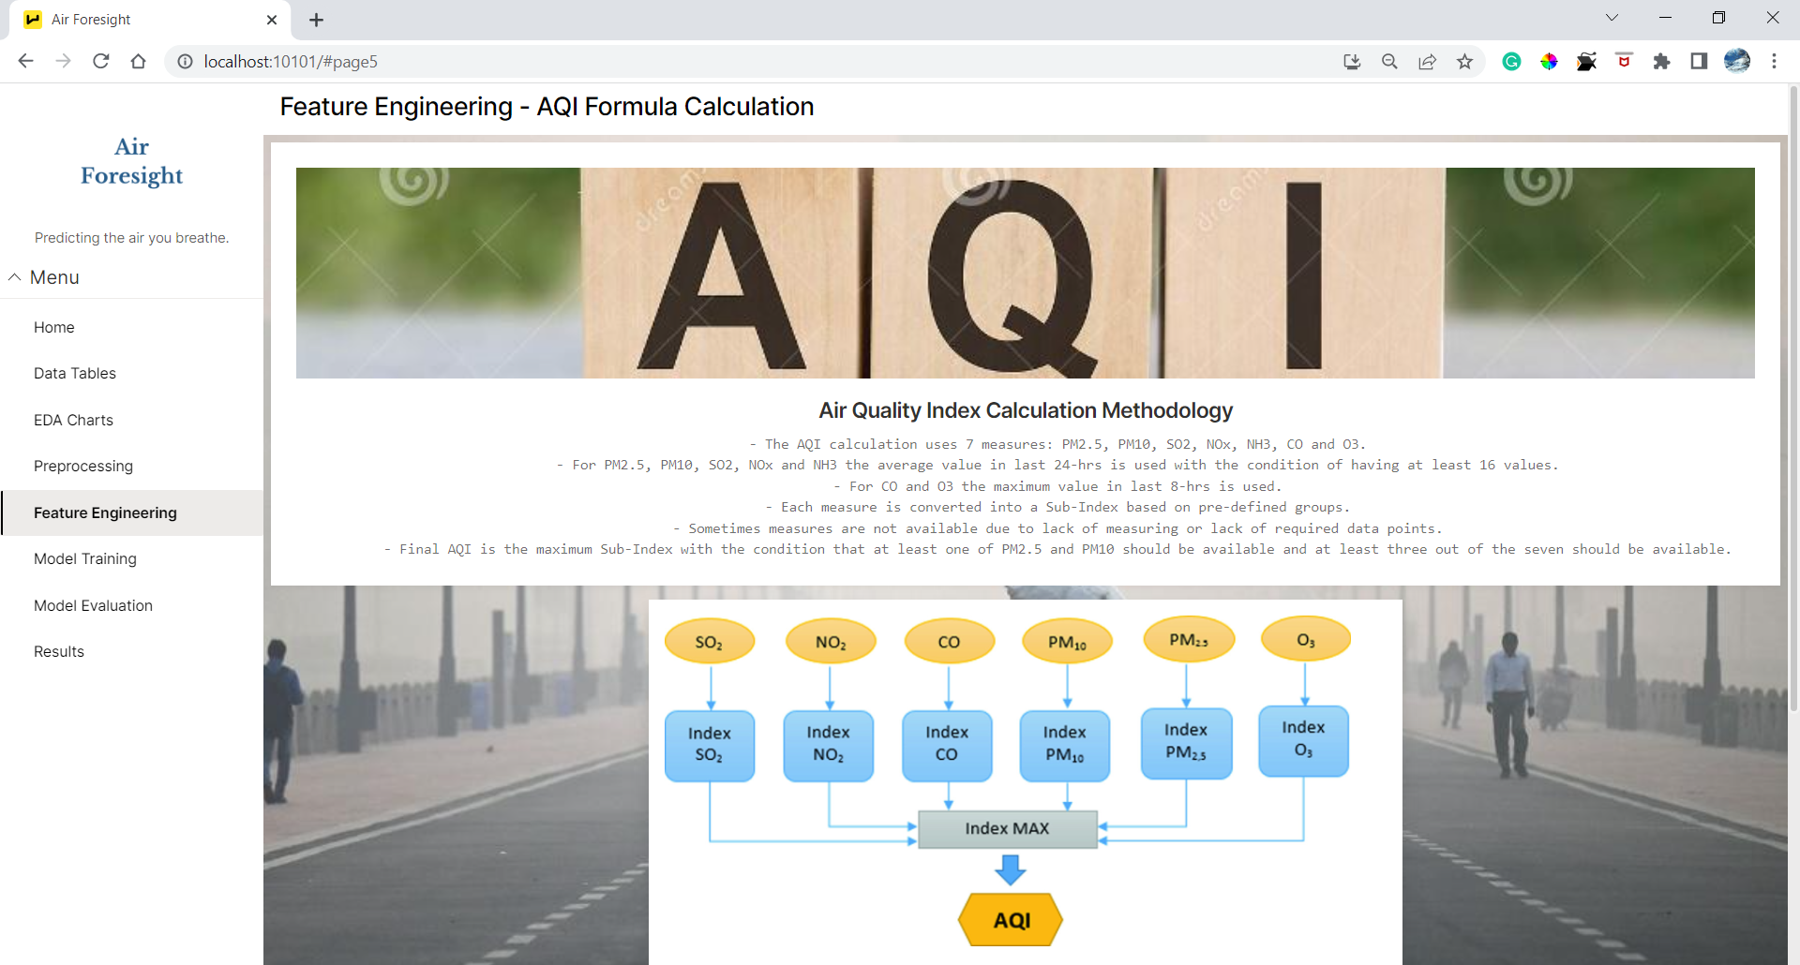
AQI Forecasting Methodology (cont.)
We also came across a formula for calculating AQI used by Central Pollution Control Board of India. (National Air Quality Index)
While the AQI values provided to us and values calculated via the formula varied, the correlation between them was found to be highest amongst other features .
This was reflected in model evaluation as well, where validation MAE scored improved as well as leaderboard MMAE score improved for Multivariate models.

Slide 5

Model Training Insights
Data Used | Model Name | Training Conditions | MMAE Score (Leaderboard)
Preprocessed data with missing dates handled and scaled data | Auto ARIMA - [UniVariate] | Location wise training | 28.5644
Preprocessed data w/o missing dates handling | Auto ARIMA - [UniVariate] | Location wise training | 29.7345
Preprocessed data w/o missing dates handled + AQI calculated column data | Auto ARIMA + H2O AutoML XGBoost | Ensemble predictions with 80% - 20% weightage | 30.2743
Preprocessed data with AQI formula calculated column | H2O AutoML - XGBoost | 80% - 20% Train, validation split according to dates. | 31.9673

Slide 6
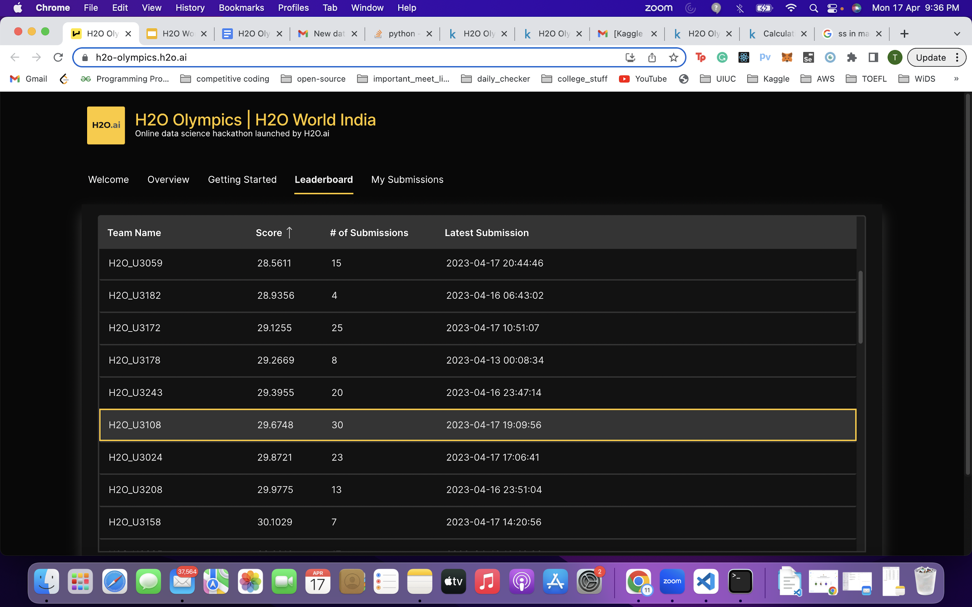
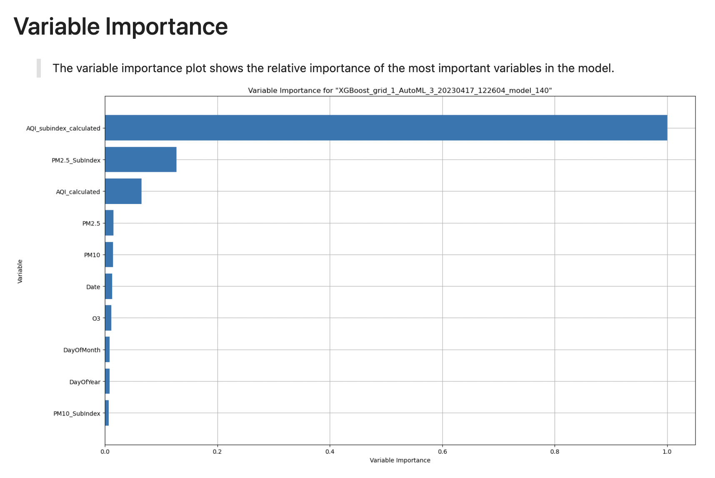
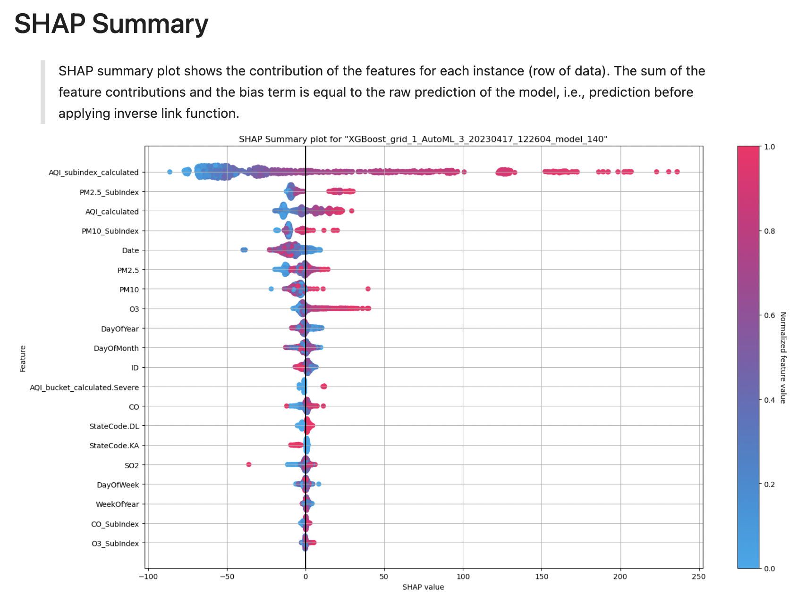
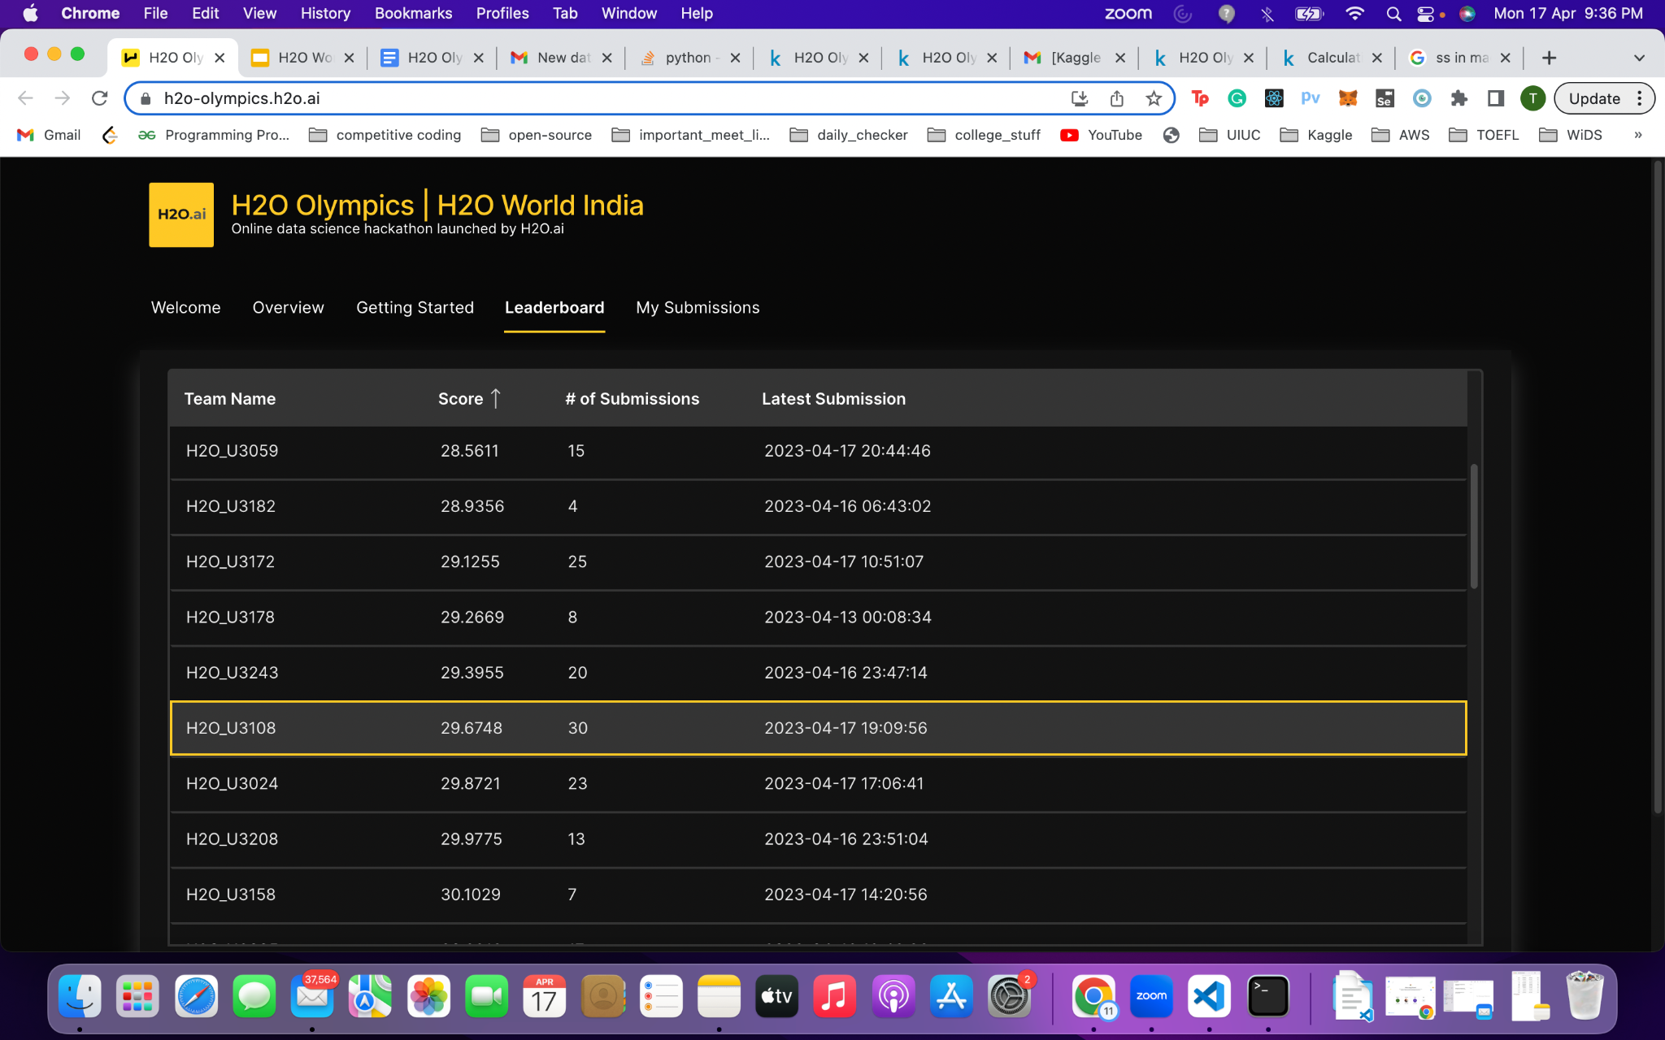
Observations & Results
Parameters of best model - Auto ARIMA - test = adf, max iterations = 1000, seasonal = True, stepwise = True
The AQI feature added, improved model.
It was observed that, though other pollutants contribute to calculation of AQI, forecasting of AQI using time series could be just as powerful.
For both univariate & multivariate models, preprocessing such as handling of missing dates & outlier handling proved to be crucial.
Business Insights
Future Scope
Our ML pipeline that predicts AQI can provide businesses with valuable insights to improve their environmental performance and operations, reduce costs, and enhance health and safety measures.
As the global focus on environmental protection and climate change intensifies, Advanced AQI prediction models would play a critical role for it.

Slide 7
Connect with us!
https://www.linkedin.com/in/trusha-talati-705747186/
https://www.kaggle.com/trushatalati
https://www.linkedin.com/in/akshat-bhat-536472199/
https://www.kaggle.com/akshatbhat

